Slide 1
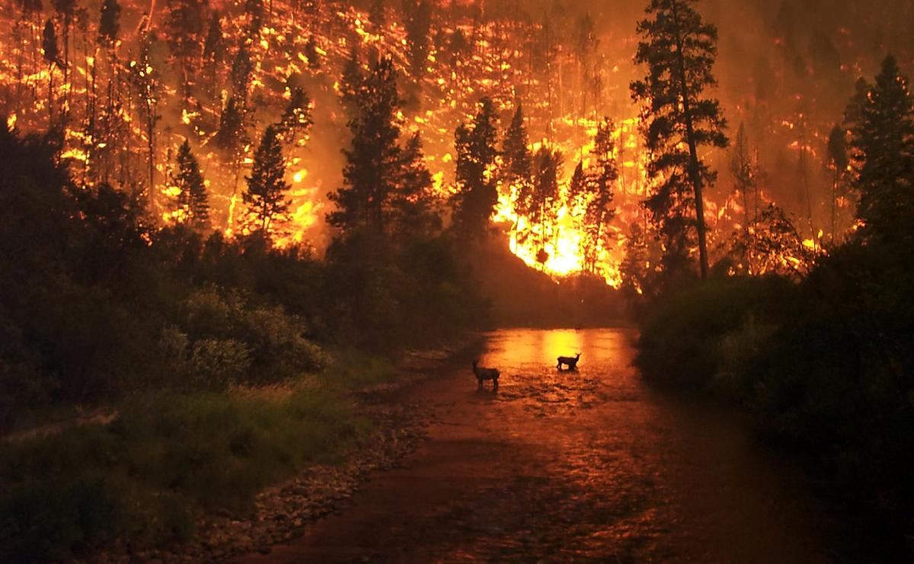
ANALYSIS ON FOREST FIRE

Slide 2
TEAM MEMBERS:
Member 1: Member 2: Member 3:
B.G.Surendra M.Shazia farheen khanum N.Chandana
2nd year 2nd year 2nd year
Bharath Institute of Bharath Institute of Sathyabama Institute of
Higher Education and Higher Education and Science and Technology.
Research. Research.

Slide 3
ABSTRACT:
Wildfires are an uncontrollable disaster which cause damages to the society as well as endanger the nature .
Forest Fire Analysis and Prediction System is built to detect the forest fires and then performs prediction of the fire spread.
With the help of big data analysis and machine learning algorithms we intend to build a tool which serves an aid to the society and thus prevent the occurrences of this disaster.

Slide 4
OBJECTIVE:OBJECTOBO IVE:
The overall objective of the project is to control and reduce the role of the forest fires as natural hazard for the Alpine environment considerably through prevention and mitigation actions. Currently forest fires play a major role in threatening the forest heritage .

Slide 5
DATA USED:
X | Y | month | day | FFMC | DMC | DC | ISI | temp | RH | wind | rain | area
7 | 5 | mar | fri | 86.2 | 26.2 | 94.3 | 5.1 | 8.2 | 51 | 6.7 | 0 | 0
7 | 4 | oct | tue | 90.6 | 35.4 | 669.1 | 6.7 | 18 | 33 | 0.9 | 0 | 0
7 | 4 | oct | sat | 90.6 | 43.7 | 686.9 | 6.7 | 14.6 | 33 | 1.3 | 0 | 0
8 | 6 | mar | fri | 91.7 | 33.3 | 77.5 | 9 | 8.3 | 97 | 4 | 0.2 | 0
8 | 6 | mar | sun | 89.3 | 51.3 | 102.2 | 9.6 | 11.4 | 99 | 1.8 | 0 | 0
8 | 6 | aug | sun | 92.3 | 85.3 | 488 | 14.7 | 22.2 | 29 | 5.4 | 0 | 0
8 | 6 | aug | mon | 92.3 | 88.9 | 495.6 | 8.5 | 24.1 | 27 | 3.1 | 0 | 0
8 | 6 | aug | mon | 91.5 | 145.4 | 608.2 | 10.7 | 8 | 86 | 2.2 | 0 | 0
8 | 6 | sep | tue | 91 | 129.5 | 692.6 | 7 | 13.1 | 63 | 5.4 | 0 | 0
7 | 5 | sep | sat | 92.5 | 88 | 698.6 | 7.1 | 22.8 | 40 | 4 | 0 | 0
7 | 5 | sep | sat | 92.5 | 88 | 698.6 | 7.1 | 17.8 | 51 | 7.2 | 0 | 0
7 | 5 | sep | sat | 92.8 | 73.2 | 713 | 22.6 | 19.3 | 38 | 4 | 0 | 0
6 | 5 | aug | fri | 63.5 | 70.8 | 665.3 | 0.8 | 17 | 72 | 6.7 | 0 | 0
6 | 5 | sep | mon | 90.9 | 126.5 | 686.5 | 7 | 21.3 | 42 | 2.2 | 0 | 0
6 | 5 | sep | wed | 92.9 | 133.3 | 699.6 | 9.2 | 26.4 | 21 | 4.5 | 0 | 0
6 | 5 | sep | fri | 93.3 | 141.2 | 713.9 | 13.9 | 22.9 | 44 | 5.4 | 0 | 0
5 | 5 | mar | sat | 91.7 | 35.8 | 80.8 | 7.8 | 15.1 | 27 | 5.4 | 0 | 0
8 | 5 | oct | mon | 84.9 | 32.8 | 664.2 | 3 | 16.7 | 47 | 4.9 | 0 | 0
6 | 4 | mar | wed | 89.2 | 27.9 | 70.8 | 6.3 | 15.9 | 35 | 4 | 0 | 0

Slide 6
ANALYSIS ON DATA:
The Forest Weather Index (FWI) System is the first part of the Canadian Forest Fire Danger Rating System (CFFDRS).
The FWI is based on weather readings taken at noon standard time and rates fire danger at the mid afternoon peak
Three Fuel Moisture Codes :
Fine Fuel Moisture Code (FFMC)
Duff Moisture Code (DMC)
Three Fire Behaviour Indices :
Initial Spread index (ISI)
Build Up Index (BUI)
Drought Code (DC)

Slide 7
LIST OF MODULES:
Importing pandas,matplotlib,seaborn,numpy
Reading the csv file
Plotting the histographs and boxplots
Finding MEAN,MEDIAN
DecisionTreeRegression
Algorithm
And find predicted y values
Printing
Meanabsoluteerror(MAE)
Meansquarederror(MSE)
RMSE
Accuracy(r^2)

Slide 8
MODULE 1:
import types import pandas as pd from botocore.client import Config import ibm_boto3 import matplotlib.pyplot as plt import seaborn as sns import numpy as np
import types
import pandas as pd from botocore.client import config
import ibm_boto3
import matplotlib.pyplot as plt
import seaborn as sns
import numpy as np

Slide 9
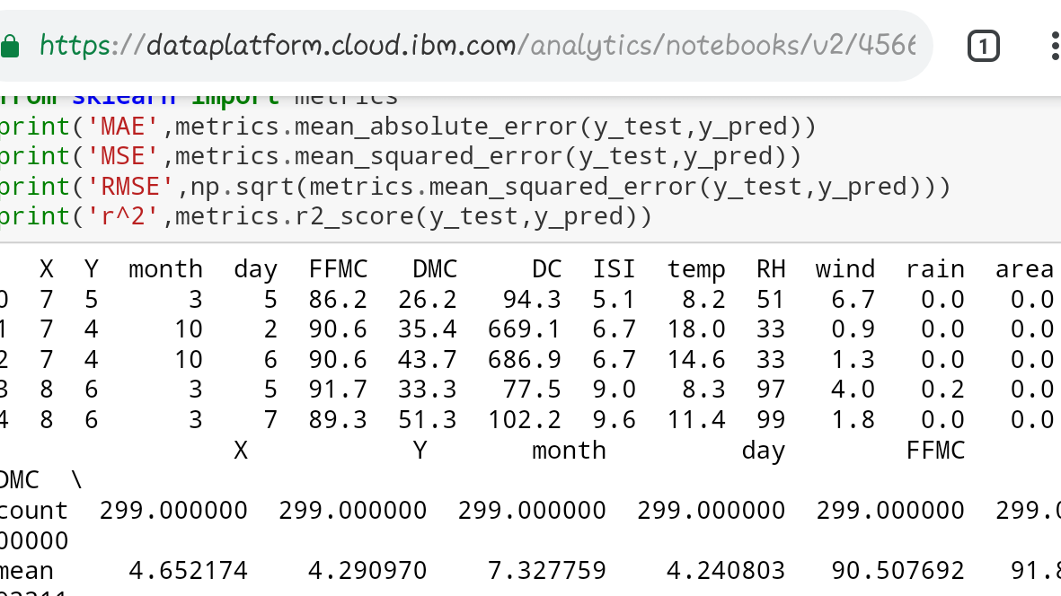
MODULE 2:
Ff=pd.read_csv(body)
Ff.head()

Slide 10
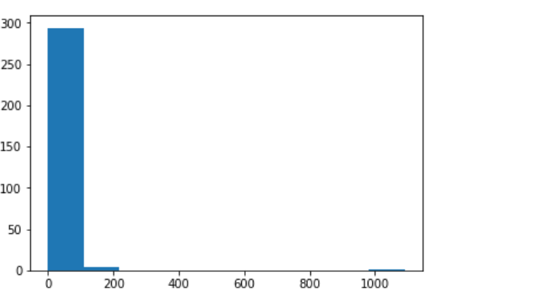
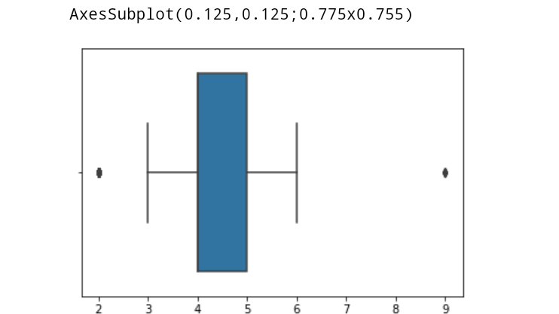
MODULE 3:
plt.hist((ff.area)) print(sns.boxplot(x=ff[‘Y’]))
Plt.show() plt.show()

Slide 11
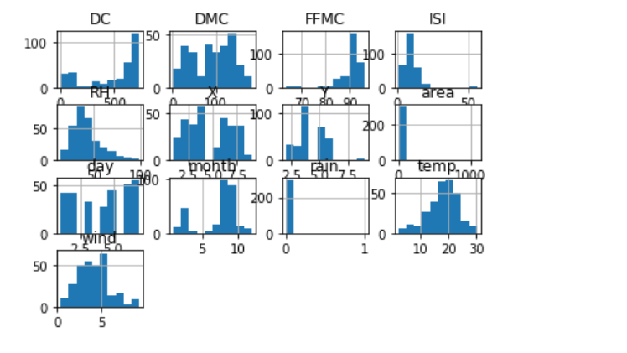
Histograms: ff.hist() plt.show()

Slide 12
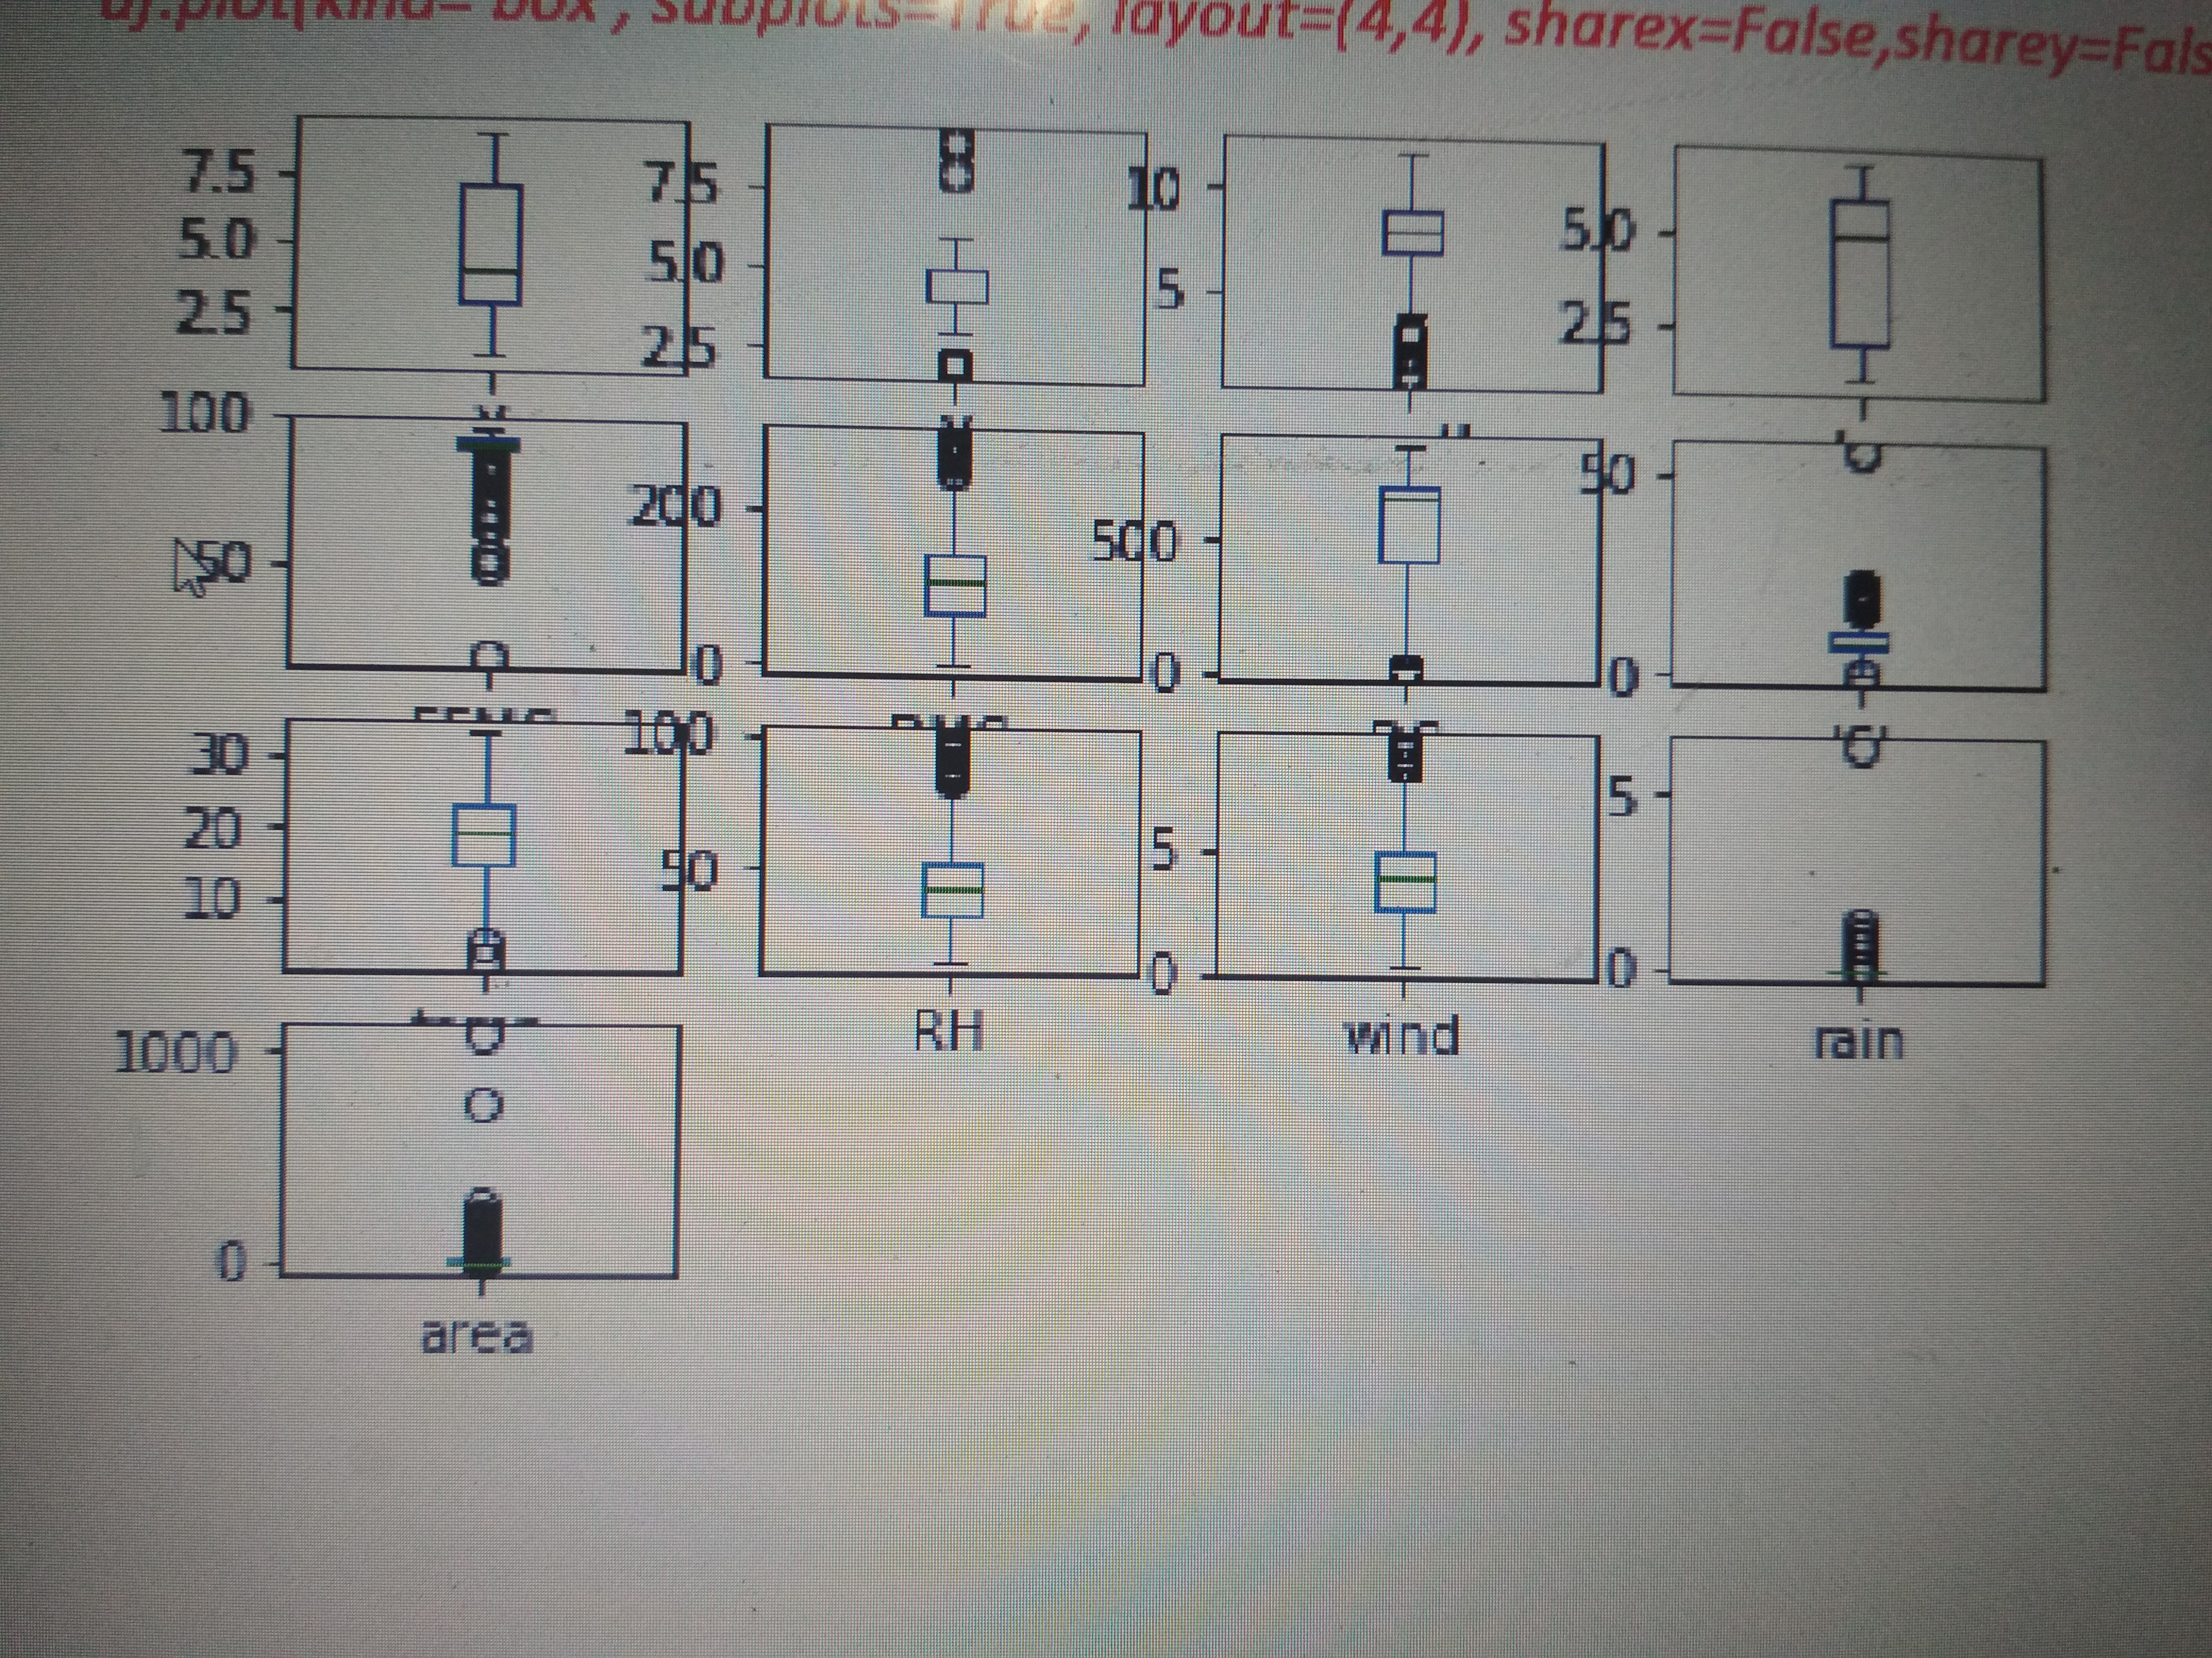
Boxplots: ff.plot(kind='box', subplots=True, layout=(4,4), sharex=False,sharey=False)

Slide 13
MODULE 4:
Mean=np.mean(ff[‘’X’],axis=0)
Sd=np.std(ff[‘X’],axis=0)
ff[‘X’]=[x for x in ff[‘X’] if(x>mean-2*sd)]
ff[‘X’]=[x for x in ff[‘X’] if(x<mean+2*sd)]
ym=ff.Y.median()
xm=ff.X.median()

Slide 14
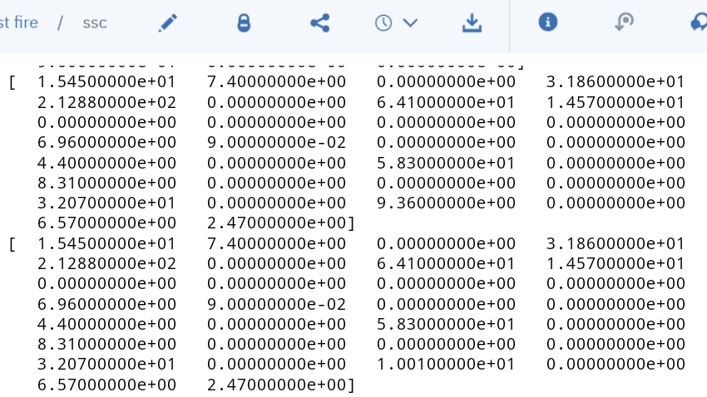
MODULE 5:
from sklearn.tree import DecisionTreeRegressor
regressor = DecisionTreeRegressor(random_state = 0)
regressor.fit(X, y)
from sklearn.cross_validation import train_test_split
X_train, X_test, y_train, y_test = train_test_split(X, y, test_size = 0.1, random_state = 0)
y_pred=regressor.predict(X_test)
print(y_pred)
print(y_test)

Slide 15
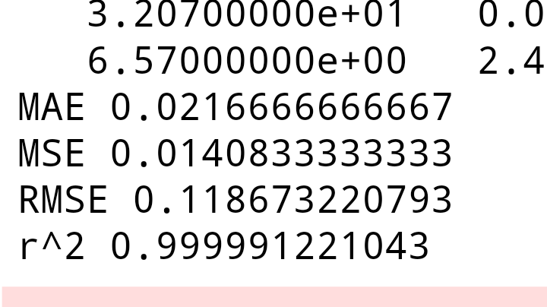
MODULE 6:
from sklearn import metrics
print('MAE',metrics.mean_absolute_error(y_test,y_pred))
print('MSE',metrics.mean_squared_error(y_test,y_pred))
print('RMSE',np.sqrt(metrics.mean_squared_error(y_test,y_pred)))

Slide 16
LIMITATIONS:
Variations in spatial and spectral resolution of remotely sensed data,environmental conditions and disturbance regimes.
We can prevent forest fire from occurring but we cant control it.

Slide 17
Conclusion:
Incidents of Forest Fires in size, frequency and intensity are controlled by weather variables .
Here by, we conclude that we can predict the forest area that burned due to forest fires.
We can save the forest area as well as the wild life by our project data.

